Slide 1

Instacart Grocery Analysis

Slide 2
Instacart
Objective: To learn more about the customer base and shopping habits of Instacart customers to provide insights into segmentation for the marketing and sales teams.
Context: There are a variety of customers in the Instacart database. To make our marketing and sales more specific, this analysis will search for trends among sub-groups of customers. The sub-categories will be based on variables that include age, income, location, shopping behavior, and more.

Slide 3
Instacart
Data Preparation
Wrangling Procedures done in Python
Duplicate searches
Data consistency checks
Missing value searches and evaluations
Data type changes for efficiency
Column name changes
Unnecessary column drops
Low-order customer exclusion
PII protection changes
Data set merges
Missing Values
This data set contained several missing values, which is the cleaning aspect that involved the most judgement.
There were many missing names, which ultimately was dropped from the data set to hide PII
To change some data types, we could not have missing values. In these instances, the missing values were relatively small (1% of the data or less) so we excluded those from our data set.

Slide 4
Instacart
Classification Columns Created
To help with the analysis, we created different categories and flags to define our customer base and products into smaller, more usable groups. This included:
Dividing the 50 States into four regions to fit the census bureau designated regions, upon request from the marketing team. The four regions are the Northeast, Midwest, South, and West.
Creating three loyalty categories based on how many orders they placed
Created age ranges with ten-year age groups
Labeling all prices as low, mid, or high
Defining customers as low or high spenders
Identifying how many total orders a customer has placed
Labeling our busiest days and busiest orders

Slide 5
Instacart
Marketing and Sales Questions
What are the busiest order times and days?
What are the most profitable times?
What’s the distribution of our customers loyalty?
What products are the most popular?
How can we segment different customers?
How do different customers behave?

Slide 6
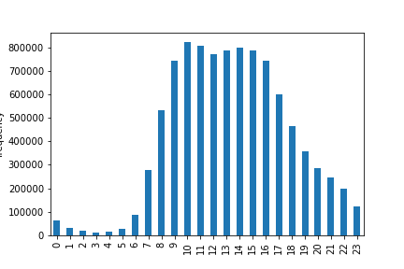
Instacart
What are the busiest order times and days?
This histogram shows the number of items purchased by hour of the day (military time). The busiest hours are 10am-3pm, which each have about 750,000-800,000 orders.
Contrast this with the hours of 8pm to 7am, which fall under 300,000 items.
This time/order pattern holds true on the weekends as we..

Slide 7
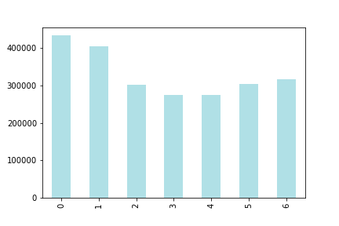
Instacart
What are the busiest order times and days?
This bar chart shows the number of items purchased by day of the week where Saturday = 0.
The highest number of items purchased happens on the weekends, which both hit close to 400,000 items per day, compared to the weekdays which average around 300,000 items.
In further analysis, one could analyze the difference between items ordered during the week vs the weekend.

Slide 8
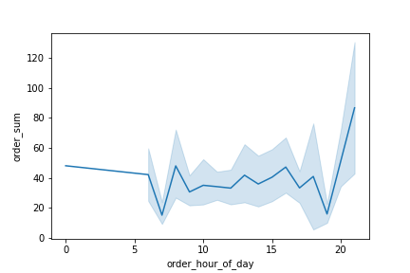
Instacart
What are the busiest order times and days?
What are the most profitable times?
This chart shows the average total price of an order over the hours of the day. There’s fluctuation throughout with two distinct peaks at 3pm, where the average order is $100, and 9pm, where the average order is about $140. The other hours fluctuate from about $25-$75 per order.
While more total items are purchased during the 10am-3pm time slot, more expensive orders are placed in the evening.

Slide 9
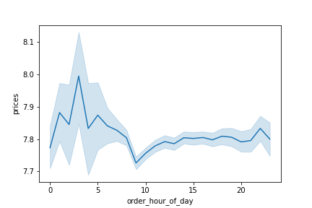
Instacart
What are the busiest order times and days?
What are the most profitable times?
The below line chart shows the average price of an individual item by the hour of the day. There’s a spike at 4am where the average item is about $8 and during the day, it stays around $7.80. Not a huge fluctuation, but it does have a distinct pattern.

Slide 10
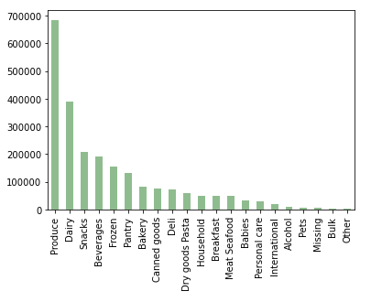
Instacart
What products are the most popular?
What are the busiest order times and days?
What are the most profitable times?
The left chart shows the number of items purchased by department. By far, produce has the highest number of purchases, coming close to 700,000 items purchased. Then next most popular are Dairy, Snacks, Beverages, and Frozen Foods.

Slide 11
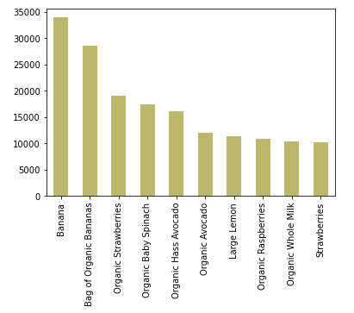
Instacart
What products are the most popular?
What are the busiest order times and days?
What are the most profitable times?
This chart shows the top ten most popular products. The number one most ordered product is Bananas, with close to 35,000 purchase. Nine of the top ten items are in the product department.

Slide 12
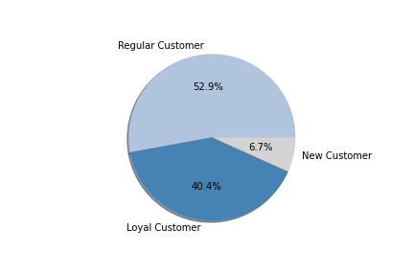
Instacart
What’s the distribution of our customers in terms of brand loyalty?
What are the busiest order times and days?
What are the most profitable times?
This pie chart shows our percentage breakdown of regular, loyal, and new customers. Note that many new customers were eliminated from this data set.
The loyalty status is defined by the following:
New Customer: <10 Orders
Regular Customer: 10-40 Orders
Loyal Customer: 40< Orders

Slide 13
Instacart
What are the busiest order times and days?
What are the most profitable times?
How can we segment different customers?
To segment customers, we looked at Income, Family Status, Number of Dependents, Region, and Age. For this analysis, there are five profiles that include a few key characteristics from each. They are:
Middle Age Married Parent
Older Divorced Adult
Young Married Parent
Young Single Independent Adult
Young Single At Home Adult
There was no significant difference in the profiles in the following categories:
Order day of week
Order hour of day
Number of orders
High/Low spender ratios
Loyalty status

Slide 14
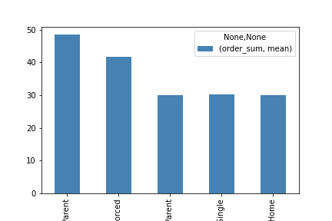
Instacart
How do different customers behave?
What are the busiest order times and days?
What are the most profitable times?
The only analysis that showed a significant difference in the profiles was that of the cost of the average order.
The Middle-Aged Married Parent spent close to $50 on average for an order, which is almost $20 more than what the younger profiles do.
Middle Age Married Parent
Older Divorced Adult
Young Married Parent
Young Single Independent Adult
Young Single At Home Adult

Slide 15
Instacart
Key Findings and Recommendations
There’s potential to market more to off-peak hours, including 7am-9am and 5pm-10pm. Our highest item hours are 10am-3pm.
More expensive items are purchased 2am-4am and the most expensive orders are purchased 3pm and 9pm.
Middle Aged Married Parents spend the most per order and are a significant portion of our market.
A high percentage of our customers are loyal and/or regular.
For future analysis, there’s potential to create more specific profiles based on those we want to target. One could either try and target the customers who are lower spenders to try and convert them to high spenders, or try and expand the market around those who are already high spenders.

Slide 16
Instacart
Sources
“The Instacart Online Grocery Shopping Dataset 2017”, Accessed from https://www.instacart.com/datasets/grocery-shopping-2017
Customers Data Set
Data Dictionary

